Slide 1
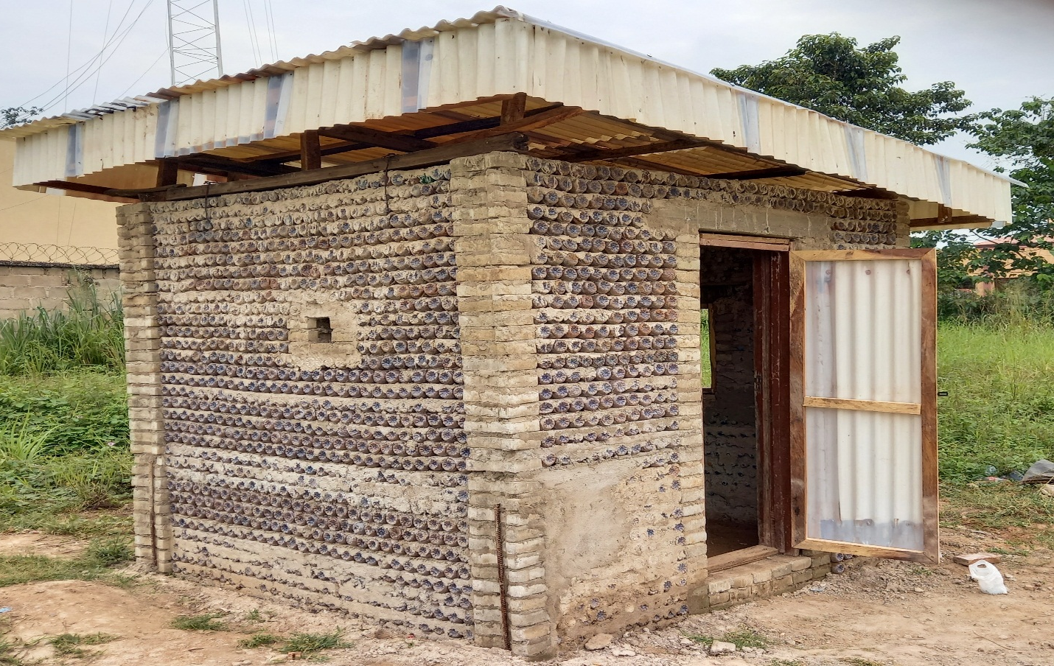
PET-BOTTLE SECURITY HOUSE (PET BOTTLES AS AN ALTERNATIVE TO BUILDING MATERIALS FOR ENVIRONMENTAL SUSTAINABILITY)
Wara S.T, Enyinnia C.E, Ibitoye O., Ohai C.P, Ogunje F.S, Wara, H.U., Agunbiade O.S
Nornah-awoh A., Ozobokeme D., Owolabi O., Ndukwe S., Ibekwe F., Kehinde O.
Department of Electrical/Electronics and computer Engineering
AFE BABALOLA UNIVERSITY ADO-EKITI (abuad)
november 13TH, 2022

Slide 2
OUTLINE
INTRODUCTION
DESIGN: SOFTWARE AND PROCESS
BOTTLE COLLECTION & PREPARATION
SETTING OUT AND BUILDING
COMPLETED BUILDING MODE
CONCLUSION

Slide 3
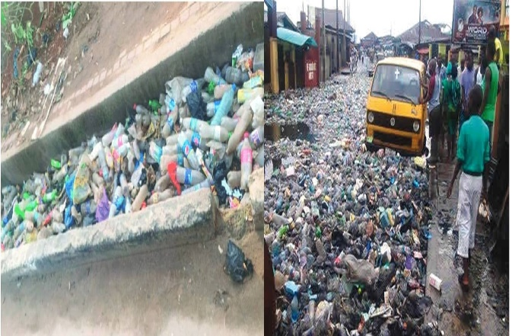
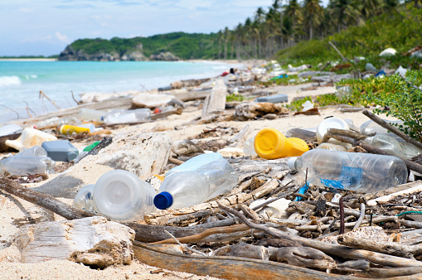
introduction
Plastic wastes littering the road drains, waterways and environment are very common in both urban and rural areas today , as rapidly increasing production of disposable plastic products overwhelms the world’s ability to deal with them.
Notes:
Plastic pollution due to the increasing production and poor disposal and recycling culture and these leads to:
Environmental pollution and clogged drainages
Disruption of aquatic life
Reduction in water percolation and normal agricultural soil aeration
According to the World Economic Forum, the world’s oceans will be filled with more plastic mass than fish mass by 2050.
Plastic is a non-biodegradable material and it has been found that it can remain on earth for about 4500 years without showing any signs of degradation.
A way of eliminating plastic waste and reducing the threat they pose to our environment is by reusing them.

Slide 4
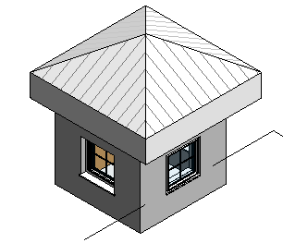
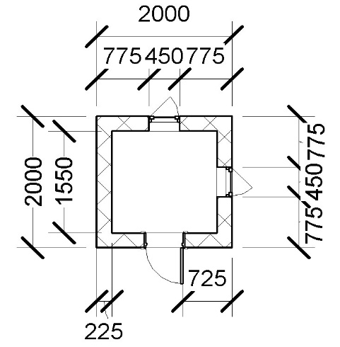
design: software and process
A software Revit was used to design the building plan and determine the area of the building. (2M x 2M x 2.5M)

Slide 5
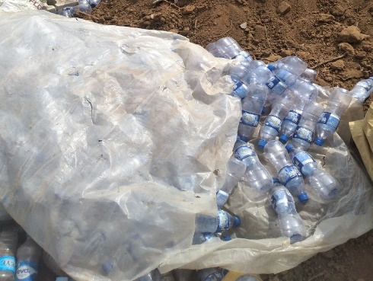
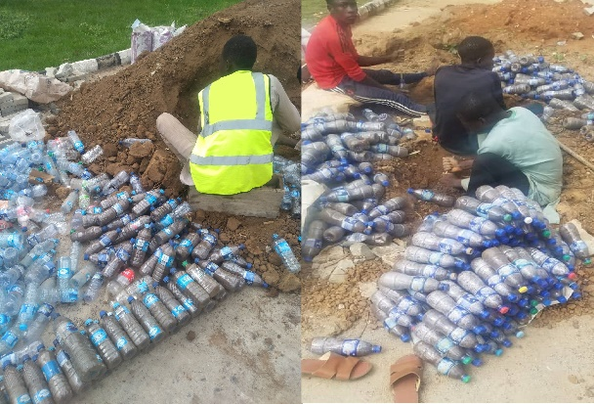
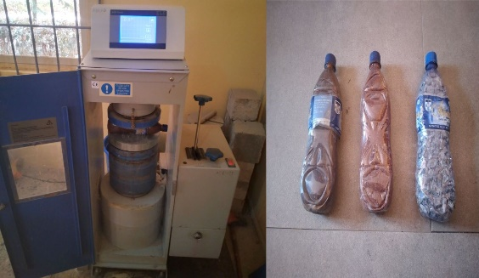
Material collection and preparation
Civil works: ABUAD Plastic Bottles, Concrete interlocks, 6tons of laterite and Iron rod
Roofing Works: Hardwood, Binding Wires, Nails and Plastic Roofing Sheets
Gathering of discarded ABUAD plastic bottles
Filling the PET bottles with laterite, then sealing the PET bottles with the provided plastic caps.
Compressive strength test on sample PET bottles filled with laterite in the laboratory
Notes:
Compressive strength test

Slide 6
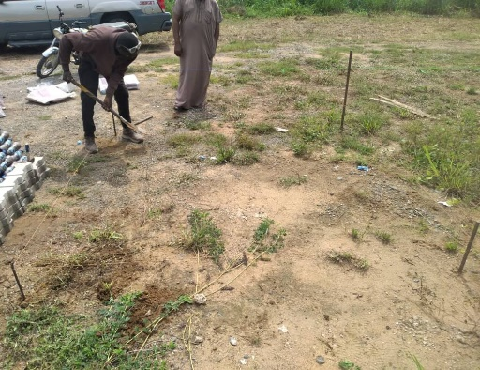
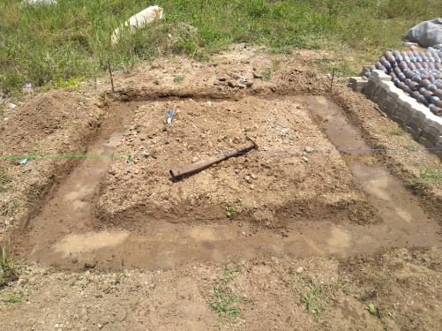
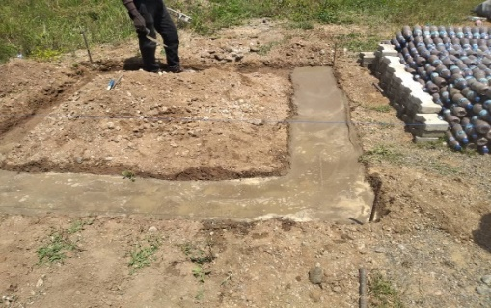
SETTING OUT and BUILDING
Clearing of weeds and debris and setting out a $2m×2 m$ space with iron rods as pegs
Excavation of a 0.2m deep trench
Trenches were blinded with mortar, which is a mixture of cement, sand, and water

Slide 7
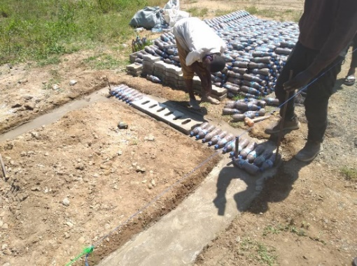
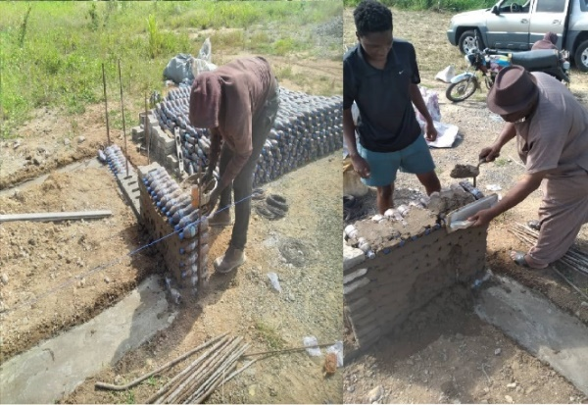
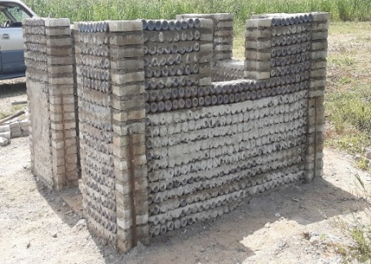
BUILDING cont’d
Laying of the First Set of PET Bottles to make the foundation, 27 bottles on each side .
Laying More PET Bottles to Raise the Building Walls
Walls plumbed, door and window dimensions provided

Slide 8
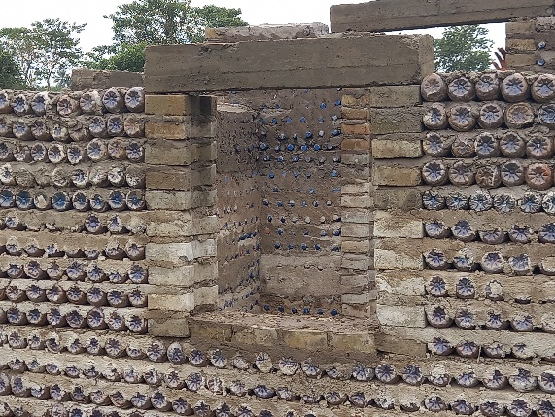
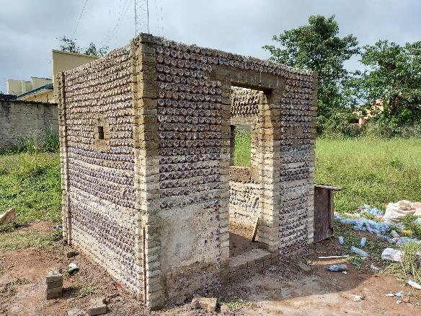
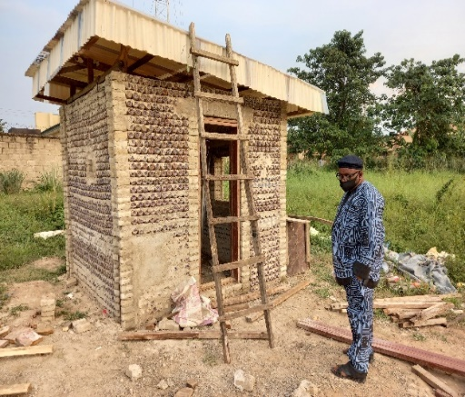
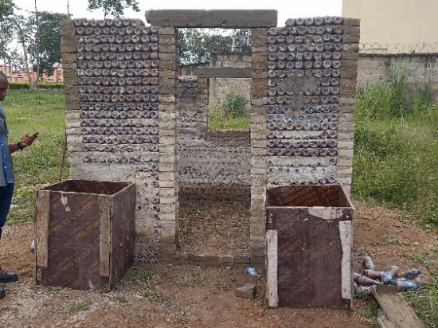
BUILDING cont’d
Casting of lintels for the doors and windows
After successfully placing the lintels, the building was further raised and a peephole was provided on the left wall of the building
The roofing style used was chosen to help with direct rainwater away from the door of the building

Slide 9
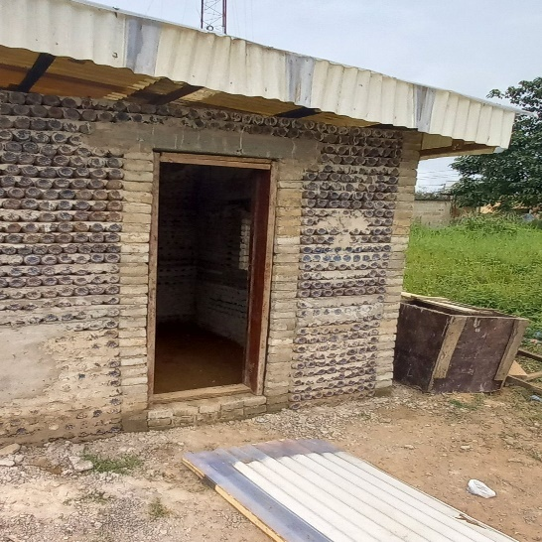
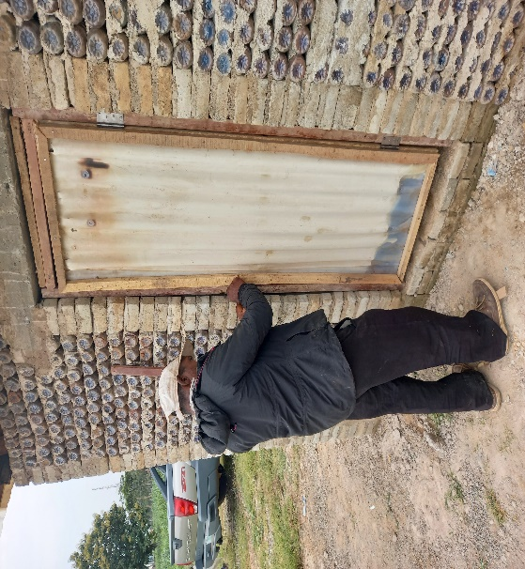
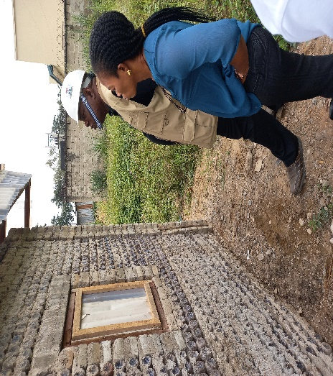
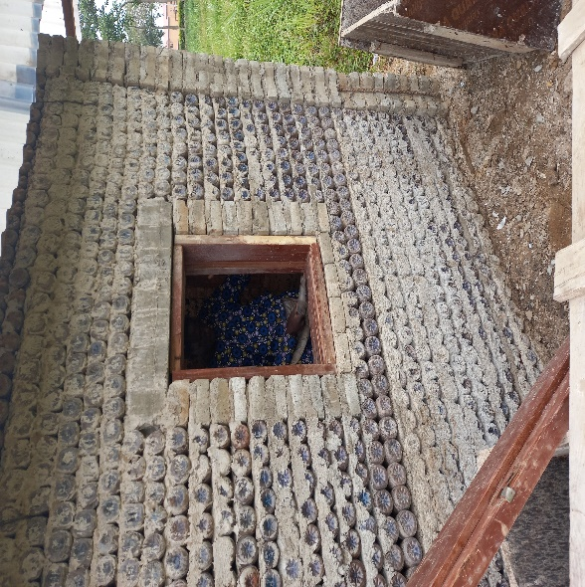
BUILDING cont’d
Formed door and window frame fixed
Door installed
Window installed

Slide 10
conclusion
This project drives the actualization and aspirations of:
the Sustainable Development Goals 11,12 and 14 on sustainable cities and communities, responsible consumption and production, life below water; and
the Presidential Executive Order 5 on execution of projects and promotion of local contents.
Can be used as Support for FGN Housing projects especially for IDP Camps
Due its high benefits, the Eco-friendly PET bottles can be used as an alternative building material in the construction sector.
There is huge environmental sustainability in the recycling and reuse of plastic bottles which are often disposed indiscriminately.
Notes:
BENEFITS
Reduces environmental degradation
Houses made of plastic bottles are bio-climatic, which means that when it is cold outside, it is warm inside and vice versa
Reusing plastic bottles in construction can have great effects by reducing the CO₂ emission in manufacturing the cement because the percentage of cement used is reduced

Slide 11
THANK YOU

